Slide 1
Technology: Python
ONLINE INTERACTION SYSTEM

Slide 2

Index
Abstract
Introduction
Literature review
Existing Method
Drawbacks
Proposed system
Advantages
Implementation
Applications
Hardware and Software Requirements
System design
Architecture
Results
Conclusion
References

Slide 3
Abstract
Online learning continues to expand at educational institutions around the globe. Educators must better understand how interaction with online course content impacts student engagement and learning. Advances in technology amplify the imperative to gain further insights into how delivery of course materials can enhance and support the learning process.

Slide 4
This study investigates student patterns of access to instructional resources provided in an asynchronous online digital literacy. In this study we mainly focus on private chat with students and faculties based on their requirement. And admin post the question and he collects the information from the students and faculties votes Based on their vote’s admin take the action for the organization.

Slide 5
Introduction
Student-to-student interaction is a vital part of any course experience. In a classroom setting, this interaction happens naturally, as students listen to each other’s comments, ask each other questions, and build rapport through frequent contact. Instructors can also foster student-to-student interaction in an online setting, but it may require building formal and informal interaction opportunities in your course design.

Slide 6
Designing for a high level of student-to-student interaction online is so important that university accrediting bodies, like the Middle States Commission on Higher Education, require evidence of it in online course and program design.
Teachers who have positive interaction with their students create classroom environments more helpful to learning and meet students’ developmental, emotional and educational needs. Teaching is a people profession that demands a large amount of time being dedicated to personal interaction. Positive teacher-student interaction has a very crucial role for effective teaching and learning to take place

Slide 7
Literature review
[1]. Web-Based Teacher-Student Interaction in a Traditional Course
Platform independent Java application to support interaction between an instructor, teaching assistants and students in a traditional on-campus course is developed. The TSI (teacher-student interaction) application includes a specialized Web server, an ordinary Web server, a mailer and a simple database. The HTTP protocol is used for all communications. Both teachers and students employ Web browsers to access the TSI server

Slide 8
[2]. Students' Interaction in the Online Learning Management Systems: A Comparative Study of Undergraduate and Postgraduate Courses
The quality of interaction between learners and online content is one of the imperative factors in determining the efficacy of web-based teaching-learning towards the creation and maintenance of sustainable learning communities. Interaction with content is an internal dialogue of reflective thought that occurs between learner and the substance. Interaction is often triggered and supported by events in the learning environment – focusing on how the learner interacts with what is to be learned.

Slide 9
[3]. A Way to Bridge the Gap between Student-Faculty Interaction
Student and Faculty Interaction (SFI) outside the Classroom” is a very important aspect of higher education experience. Which is missing in the modern education system now. It has also affected overall development of a student. This Learn Management System is a bridge for the same. This enables both faculties and students to interact with each other at any given time and anywhere.

Slide 10
[4]. Faculty and student out-of-classroom interaction: student perceptions of quality of interaction
The purpose of this study was to identify ways in which students interact with faculty members outside of the classroom and learn what students believe makes for high quality interaction. Additionally, this study sought to identify successful out-of-classroom faculty student interaction strategies from the student perspective. This knowledge can aid colleges and universities in promoting more formal and informal faculty-student out-of-classroom interaction, thereby increasing the overall quality of the undergraduate student experience

Slide 11
[5]. Online Education: Perceptions of Faculty and Administrators at Three Different Types of Institutions of Higher Education
The purpose of this study was to investigate faculty and administrator perceptions of online learning compared to traditional face-to-face instruction by exploring the factors that impact online instruction. Strategies that can lead to effective online learning environments were explored. Faculty and administrators working with online education at 6 traditional, regionally accredited, degree granting higher education institutions were included in the study.

Slide 12
Existing method
In existing method communication between students and faculties is done by manual process and also if admin wants to communicate with students and faculties it takes more time.
Disadvantages:
Difficult to communicate many students.
Private communication is not possible.
Difficult to collects the information from students and faculties.
It takes more time.

Slide 13
Proposed system
In the proposed system by using latest python technology, we build an application for easy communication and it also helpful to communicate in private manner who have authorized from admin.
Advantages:
It takes less time to communicate.
Users friendly.
Communication between the students and faculties is also done by private manner also.

Slide 14
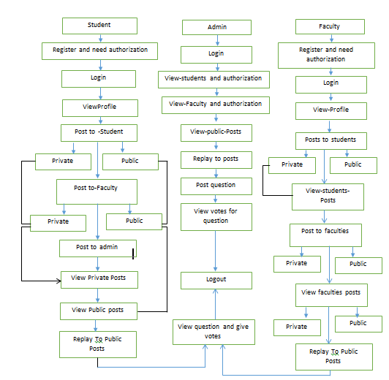
PROJECT FLOW:

Slide 15
Implementation:
Admin
1.)Admin :
1.1) Authorization:
Admin give authorization to students and faculties.
1.2) View posts :
Admin view public posts and give response to them.
1.3) Post questions :
Admin add the questions to students and faculties and collects information from them.

Slide 16
1.4) View answers:
Admin view the answers from students and faculties in the form of graph
2. Students:
2.1) student post to students and faculties:
Student post to students and faculties in private and public manner.
2.2) view posts:
Student view private posts who posted to particular student and faculty. And also View public posts.

Slide 17
2.3) View question and give votes:
Student view the question posted by admin and give response.
3. Faculty
3.1) Faculty post to students and faculties:
Student post to students and faculties in private and public manner.
3.2) View posts:
Faculty view private posts who posted to particular student and faculty. And also View public posts.

Slide 18
3.2) View question and give votes:
Faculty view the question posted by admin and give response.

Slide 19
Applications:
Colleges
Schools
universities

Slide 20
HARDWARE & SOFTWARE REQUIREMENTS
H/W Configuration:
Processor - I3/Intel Processor
Hard Disk -160GB
Key Board - Standard Windows Keyboard
Mouse - Two or Three Button Mouse
Monitor - SVGA
RAM - 4Gb

Slide 21
S/W Configuration:
Operating System : Windows 7/8/10
Server side Script : Python, HTML
IDE : pycharm
Libraries Used : pandas, matplotlib
Database : MYSQL
Technology : Python 3.6+

Slide 22
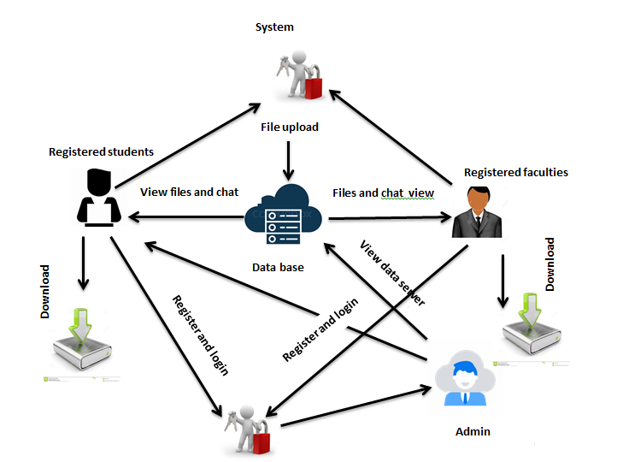
Architecture

Slide 23
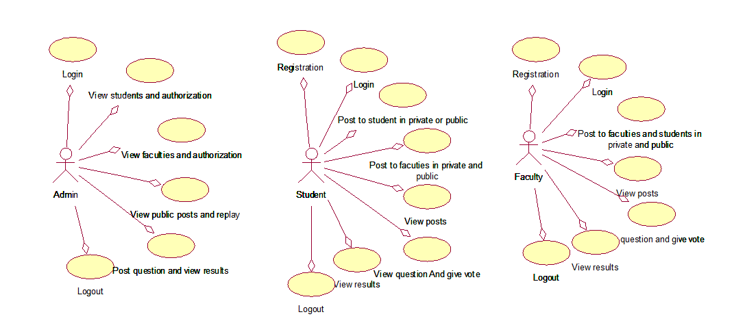
Uml diagrams
Use case diagrams:
A use case diagram in the Unified Modeling Language (UML) is a type of behavioral diagram defined by and created from a Use-case analysis. Its purpose is to present a graphical overview of the functionality provided by a system in terms of actors, their goals (represented as use cases), and any dependencies between those use cases. The main purpose of a use case diagram is to show what system functions are performed for which actor. Roles of the actors in the system can be depicted.

Slide 24
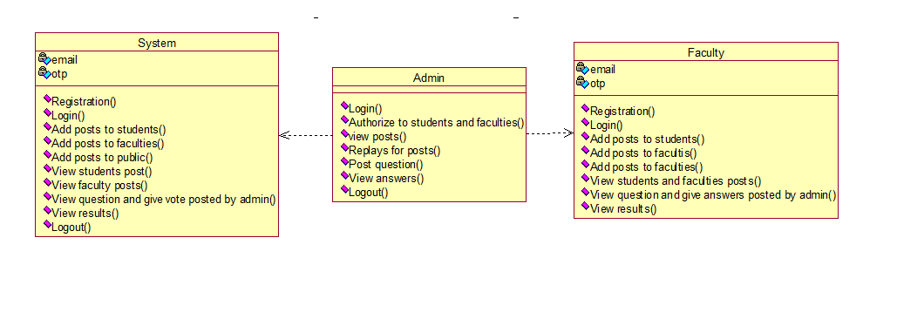
Class diagrams:
In software engineering, a class diagram in the Unified Modelling Language (UML) is a type of static structure diagram that describes the structure of a system by showing the system's classes, their attributes, operations (or methods), and the relationships among the classes. It explains which class contains information

Slide 25
Sequence diagrams:
A sequence diagram in Unified Modeling Language (UML) is a kind of interaction diagram that shows how processes operate with one another and in what order. It is a construct of a Message Sequence Chart. Sequence diagrams are sometimes called event diagrams, event scenarios, and timing diagrams.

Slide 26
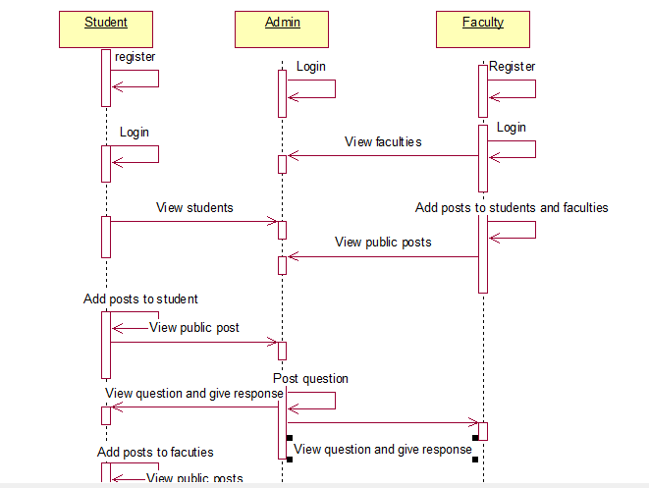
Sequence diagrams:

Slide 27
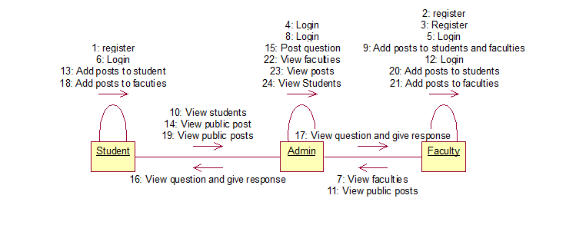
Collaboration diagram:
In collaboration diagram the method call sequence is indicated by some numbering technique as shown below. The number indicates how the methods are called one after another. We have taken the same order management system to describe the collaboration diagram. The method calls are similar to that of a sequence diagram. But the difference is that the sequence diagram does not describe the object organization whereas the collaboration diagram shows the object organization.

Slide 28
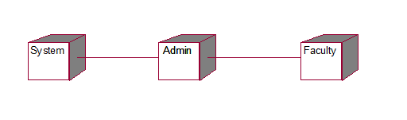
Deployment diagram:
Deployment diagram represents the deployment view of a system. It is related to the component diagram.
Because the components are deployed using the deployment diagrams. A deployment diagram consists of nodes. Nodes are nothing but physical hardware’s used to deploy the application.

Slide 29
Activity diagram:
Activity diagrams are graphical representations of workflows of stepwise activities and actions with support for choice, iteration and concurrency. In the Unified Modeling Language, activity diagrams can be used to describe the business and operational step-by-step workflows of components in a system. An activity diagram shows the overall flow of control.

Slide 30
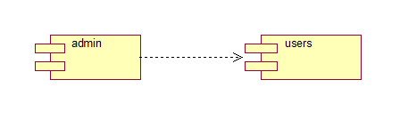
Component diagram:
A component diagram, also known as a UML component diagram, describes the organization and wiring of the physical components in a system. Component diagrams are often drawn to help model implementation details and double-check that every aspect of the system's required functions is covered by planned development.

Slide 31
Conclusion
The assessment of student achievement, or understanding what students know and can do, is fundamental to effective teaching and to students' learning. Unless teachers know students well and are knowledgeable about their achievements, they cannot be confident that they are meeting the learning needs of their students. This can be possible when we provide a free atmosphere between students and faculties by inserting private chatting with each other.

Slide 32
References
[1] Web-Based Teacher-Student Interaction in a Traditional Course
[2] A literature review on traditional herbal medicines for malaria
[3]. A Way to Bridge the Gap between Student-Faculty Interaction
[[4]. Faculty and student out-of-classroom interaction: student perceptions of quality of interaction
[5]. Online Education: Perceptions of Faculty and Administrators at Three Different Types of Institutions of Higher Education

